Slide 1
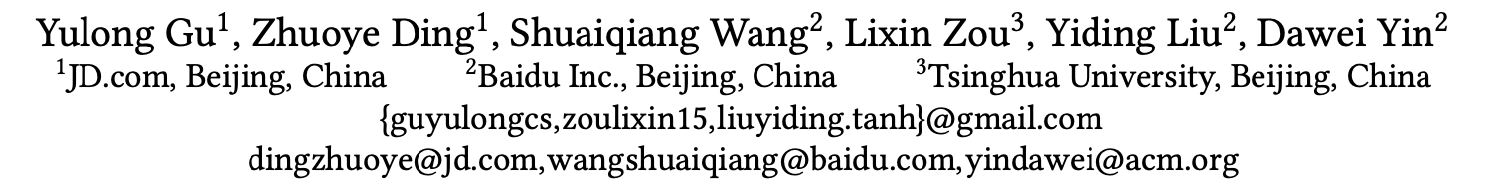
Deep Multifaceted Transformers for Multi-objective Ranking in Large-Scale E-commerce Recommender Systems

Slide 2
Deep Multifaceted Transformers for Multi-objective Ranking in Large-Scale E-commerce Recommender Systems
1. Motivation
2. Method
3. Experiments
4. Conclusions

Slide 3

1. Motivation: Challenges in E-commerce Recommender System
Multiple types of users’ behaviors:
click, cart, order
Multiple Objectives:
Click-Through Rate(CTR)
Conversation Rate (CVR)
Biases:
position, neighbors

Slide 4
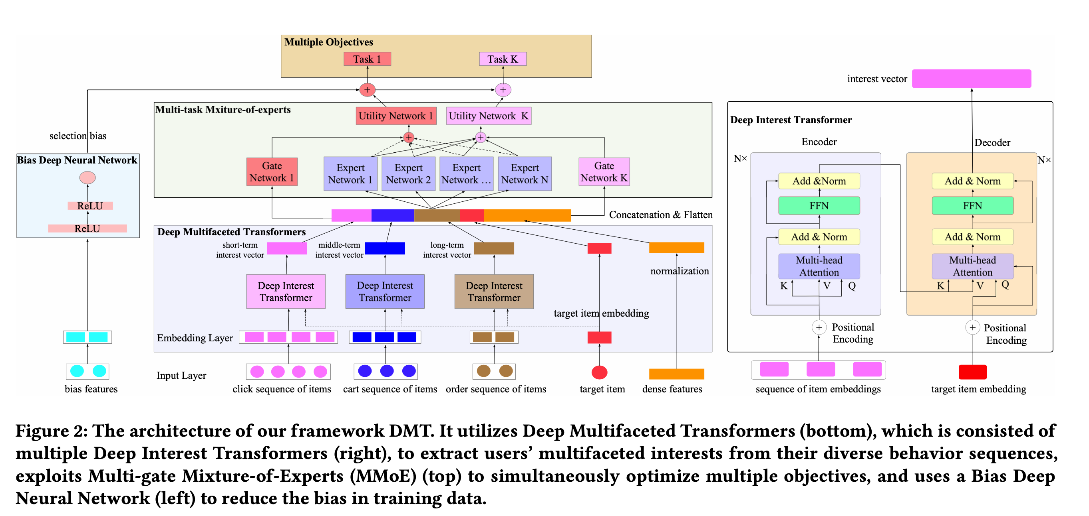
2. Method: Deep Multifaceted Transformers (DMT)

Slide 5
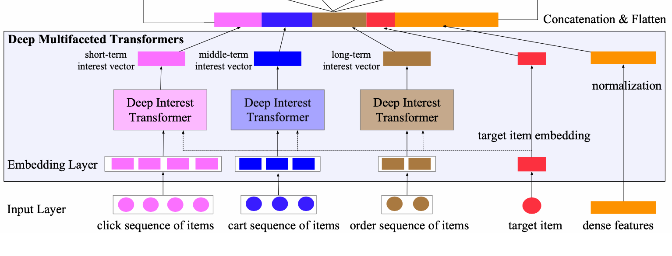
Challenge 1: Multiple types of users’ behaviors

Slide 6
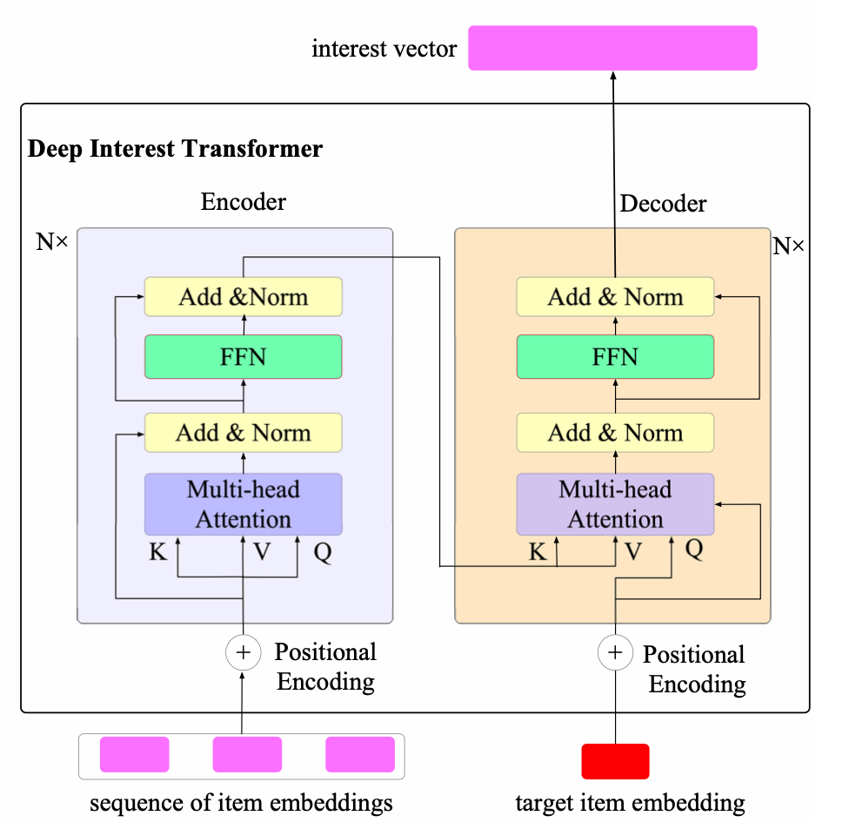
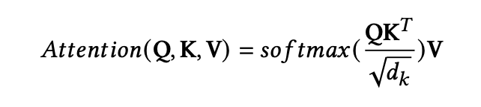
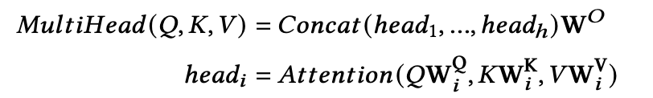
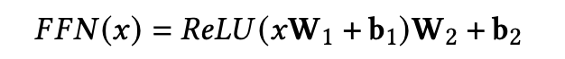
Deep Interest Transformer
Self-attention blocks:
Multi-head Self-attention:
Point-wise feed-forward:
Position encoding:
Sinusoidal/Learned Positional Embedding

Slide 7
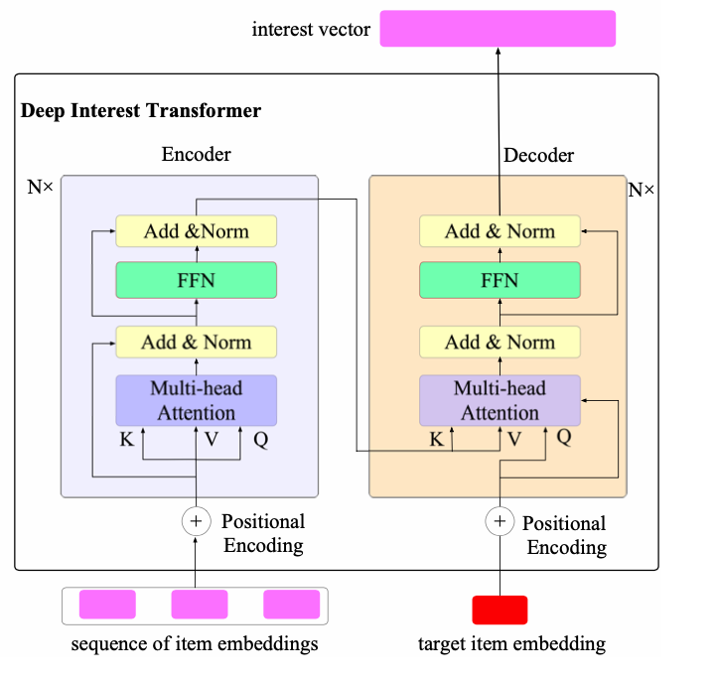
Deep Interest Transformer
Model the relationships between every pair of historical behaviors
Model the relationships of items in different aspects:
multi-head: category, style, price
Model the relationship between each historical behavior and target item:
multiple interests

Slide 8
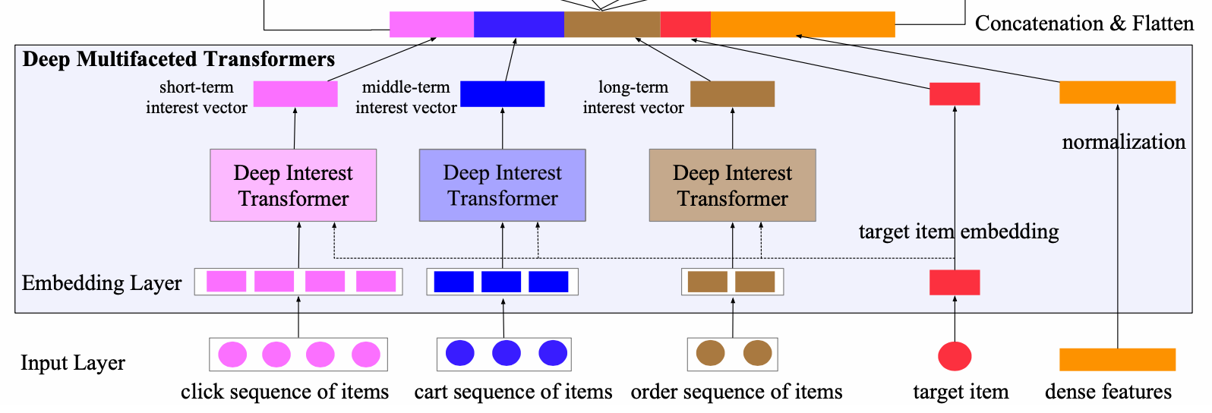
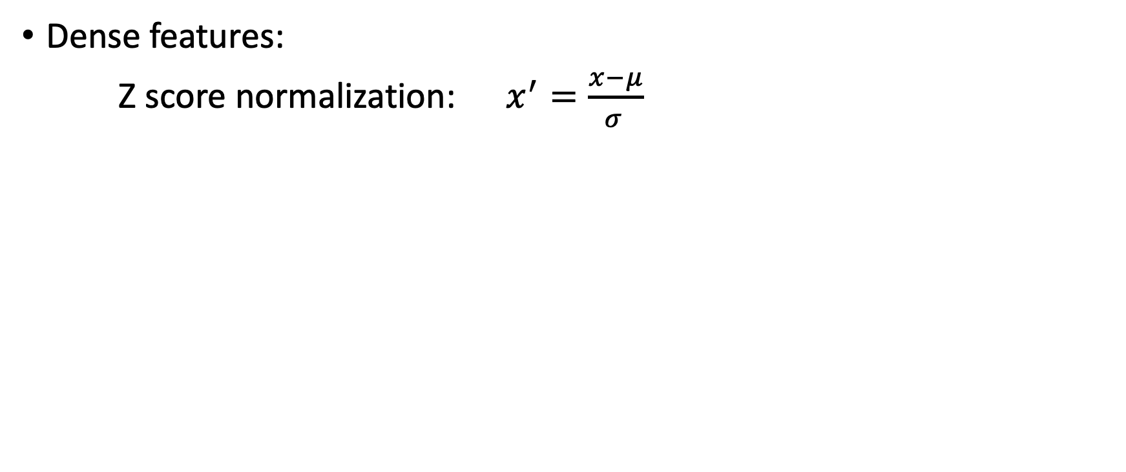
How to update GBDT to DNN models?
Dense features:
Z score normalization: $x^{′}=\frac{x−μ}{σ }$

Slide 9
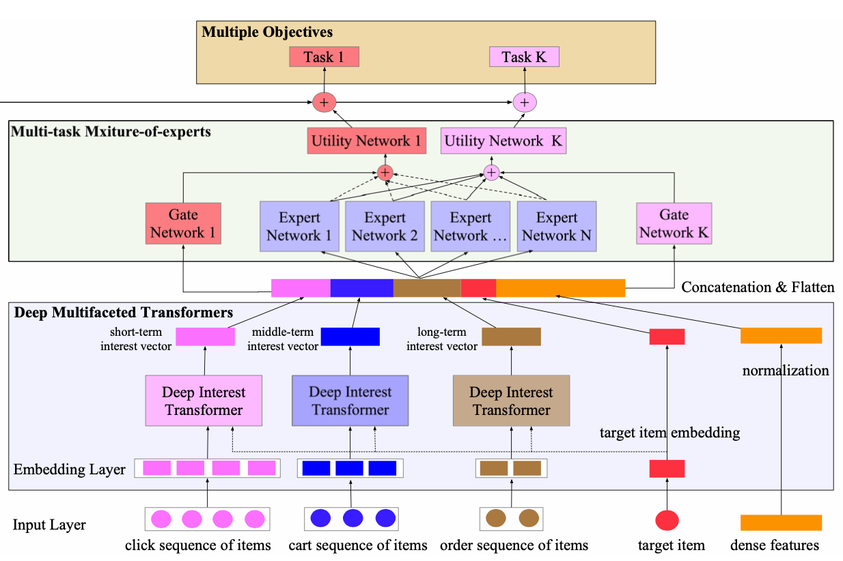
Challenge 2: Multiple objectives
(1) MMoE: Modeling the relationships and conflicts
(2) Building on the top of sequential models
(3) Solve the sparse label problem

Slide 10
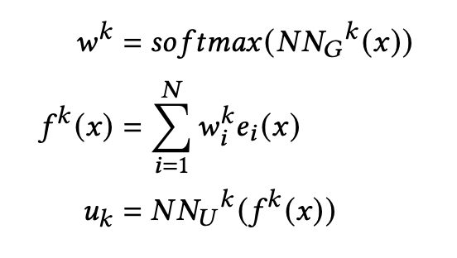
MMoE: Multi-task Mixture-of-experts
Modeling the relationships and conflicts
Building on the top of sequential models

Slide 11
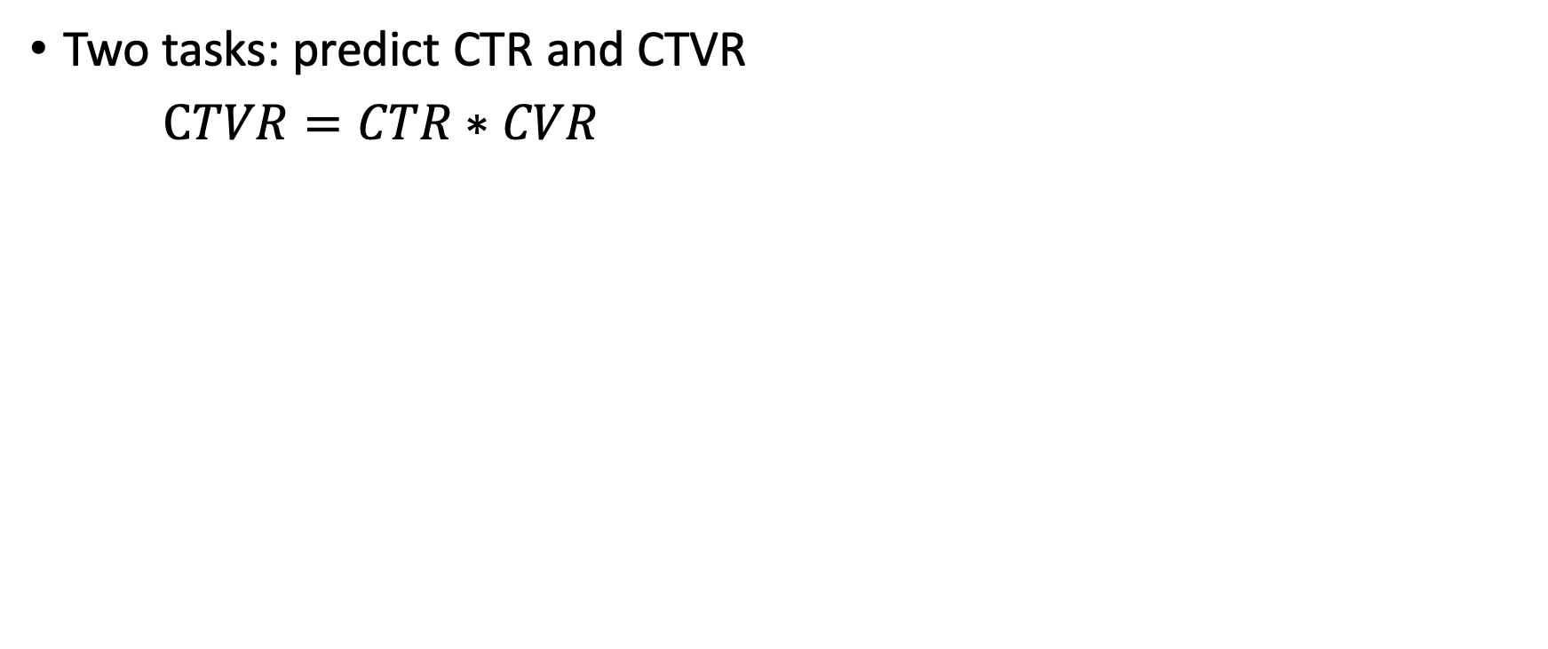
Solve the sparse label problem
Two tasks: predict CTR and CTVR
$CTVR=CTR∗CVR$
Type | Click prediction (CTR) | Order prediction (CTVR)
Impression | 0 | 0
Click | 1 | 0
Order | 1 | 1

Slide 12
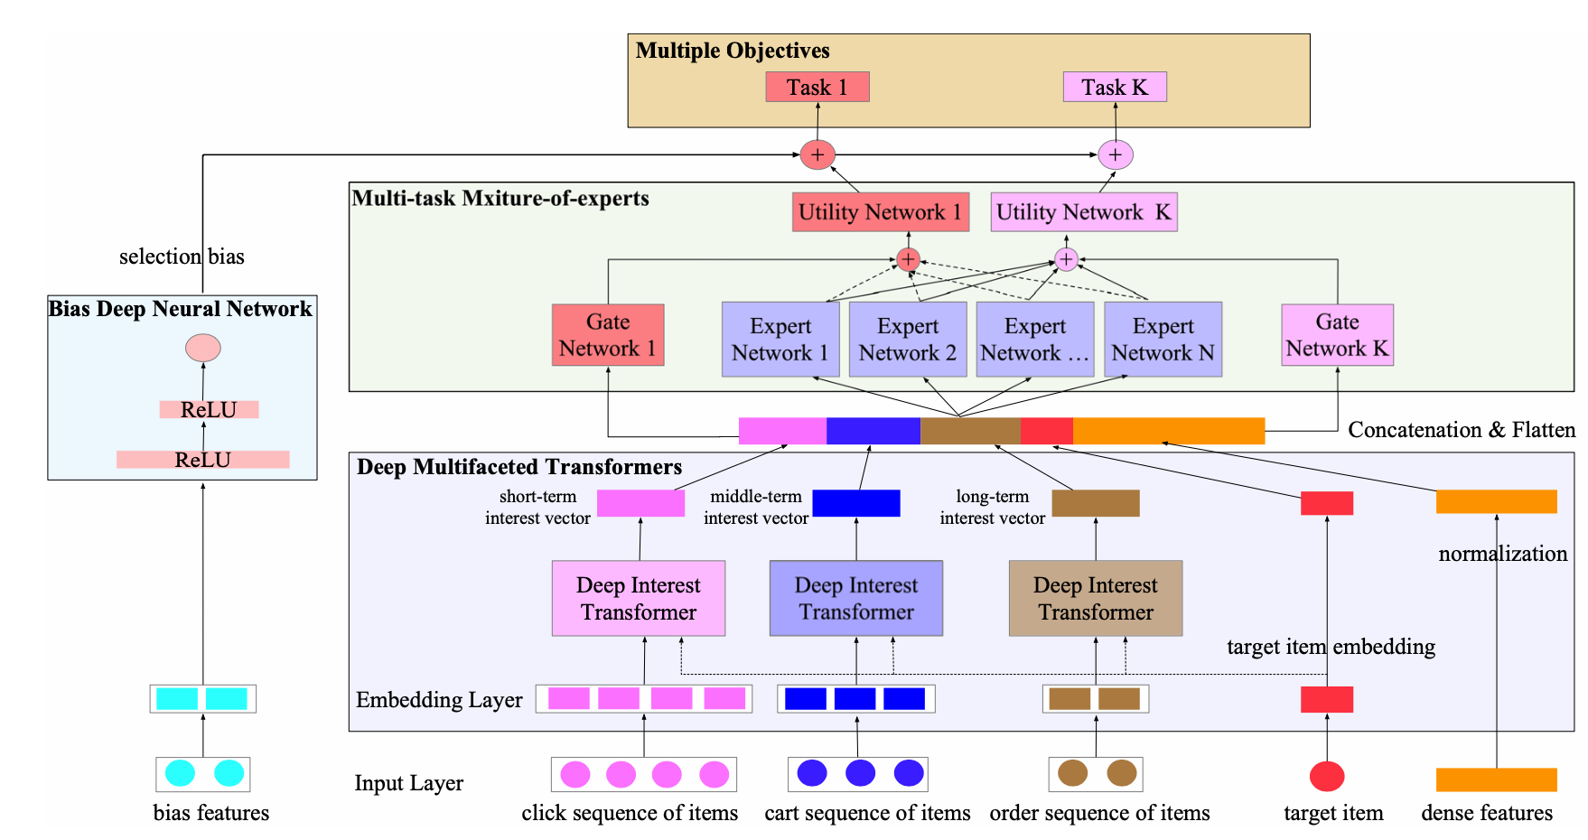
Challenge 3: Biases
Position
Neighboring

Slide 13
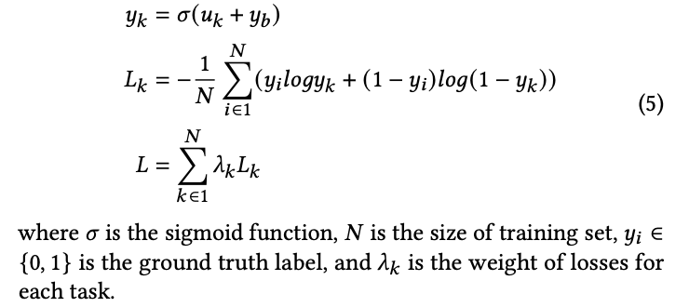
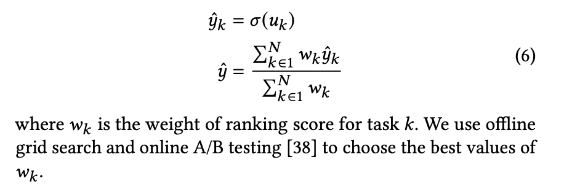
Model Training and Prediction
Training:
multi-task losses:
Prediction:
multi-task scores

Slide 14
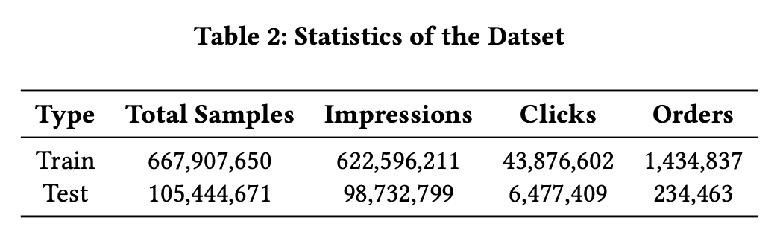
Dataset
JD Recsys Dataset:

Slide 15
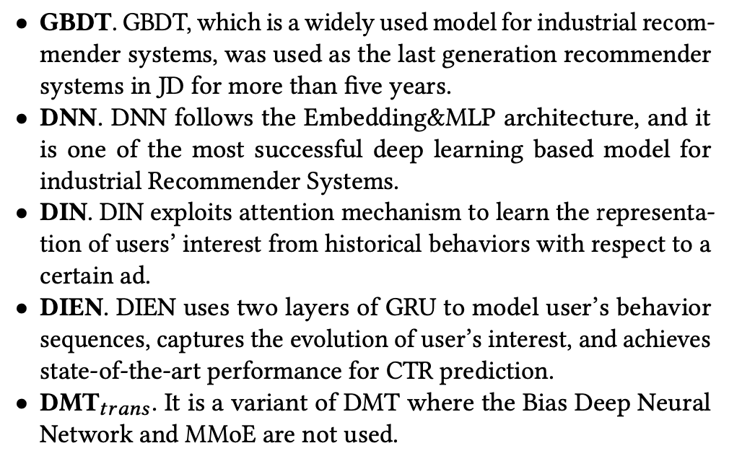
Baselines

Slide 16
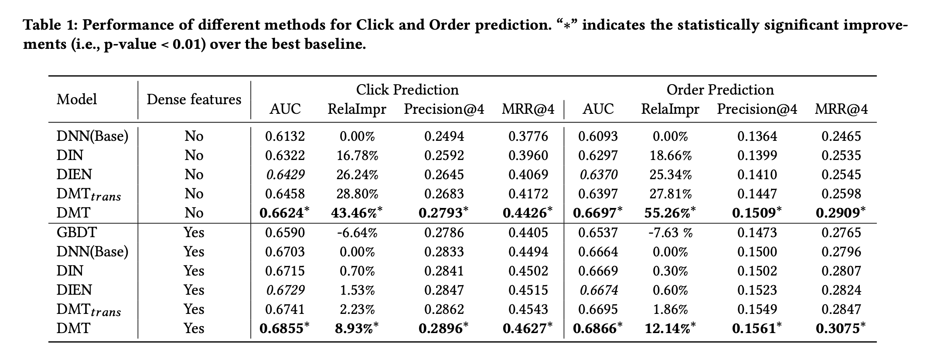
Comparison with Baselines

Slide 17
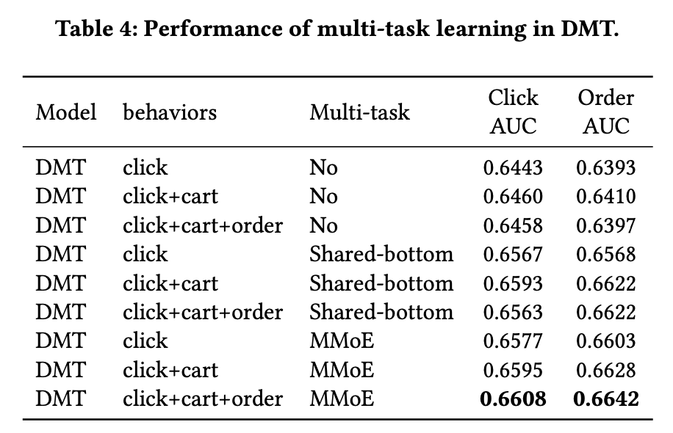
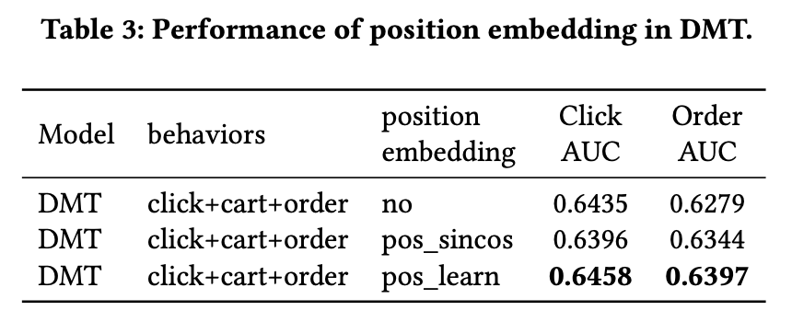
Effectiveness of Components in DMT
Deep Multifaceted Transformers

Slide 18
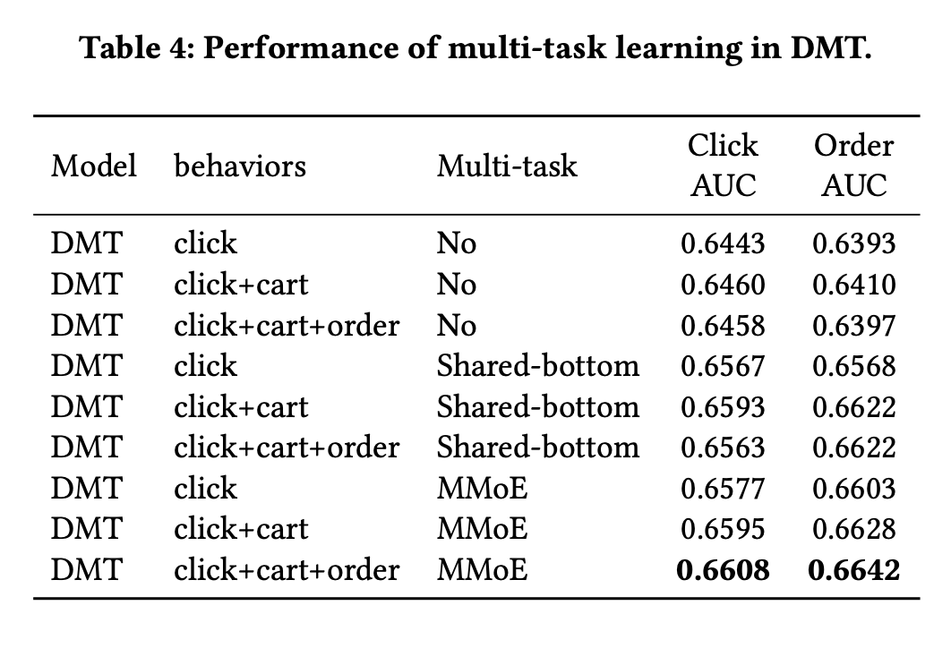
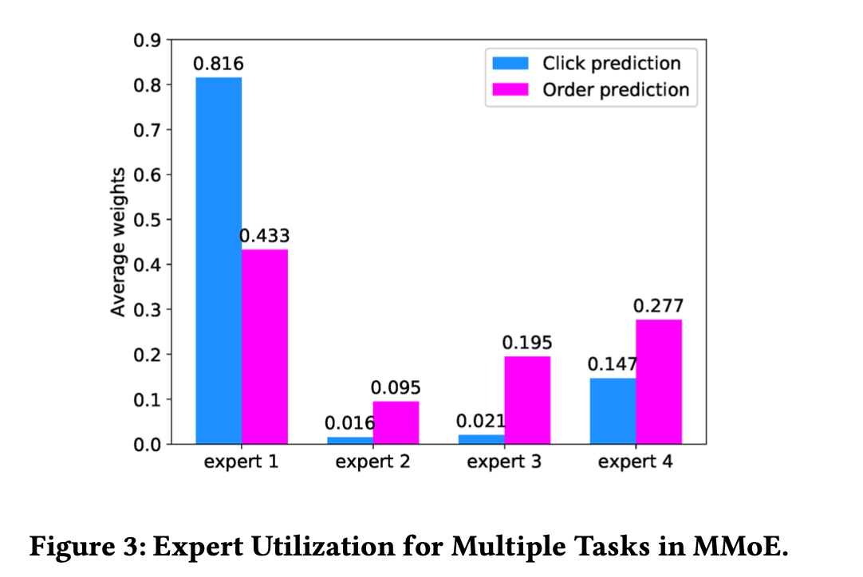
Effectiveness of Components in DMT
Multi-task Learning

Slide 19
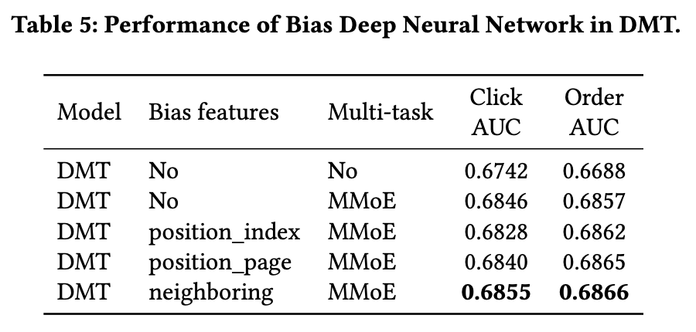
Effectiveness of Components in DMT
Bias Neural Network

Slide 20
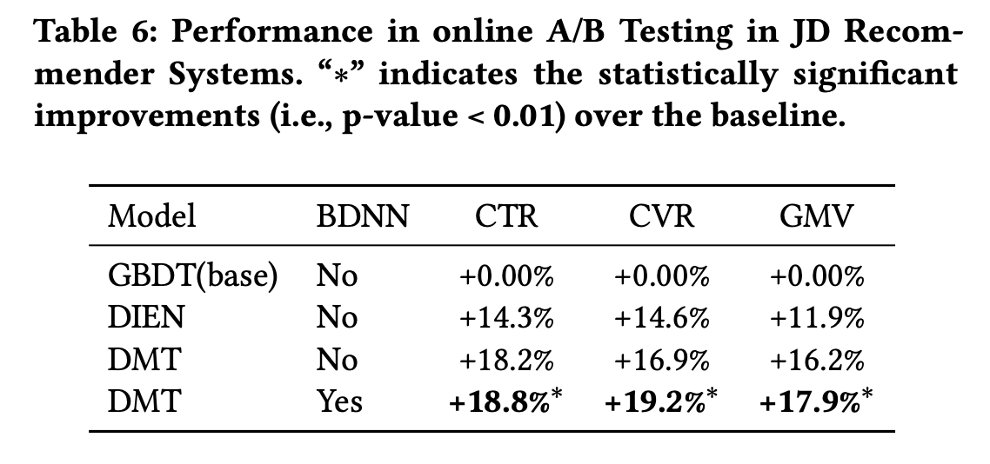
Online A-B Testing

Slide 21
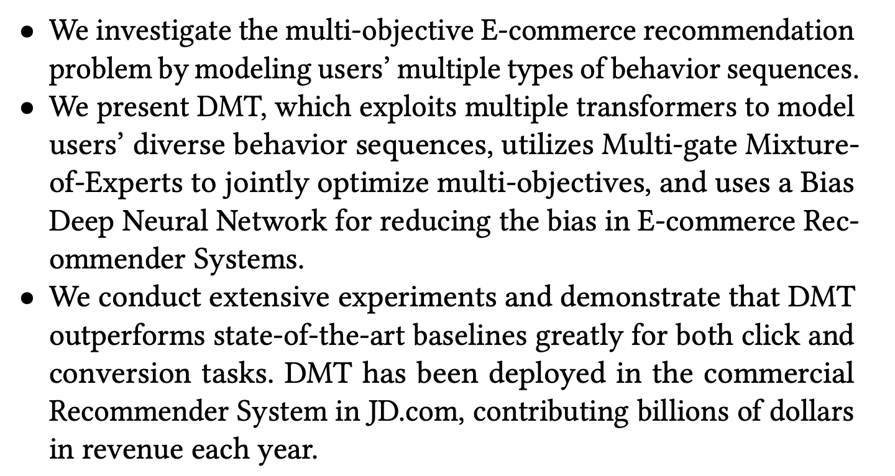
5. Conclusions

Slide 22
Thanks you for your attention!
Q&A
guyulongcs@gmail.com
Codes and datasets: https://github.com/guyulongcs/CIKM2020_DMT

Slide 23
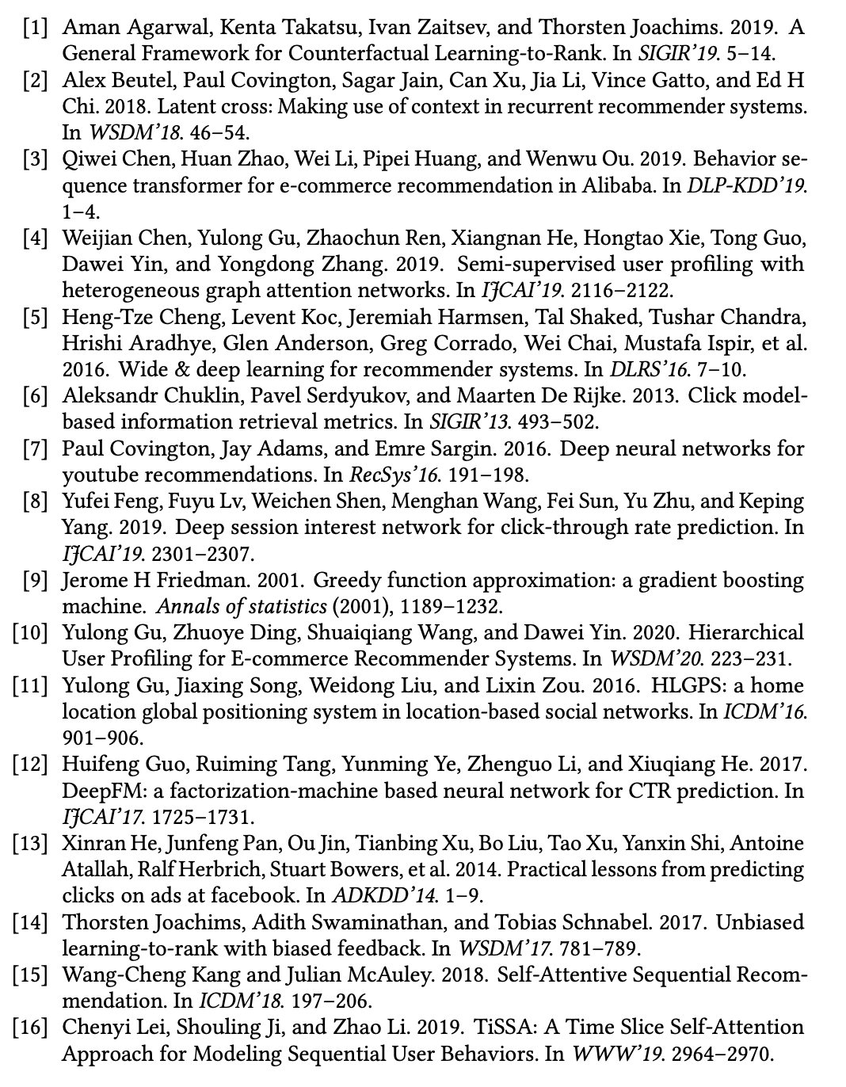
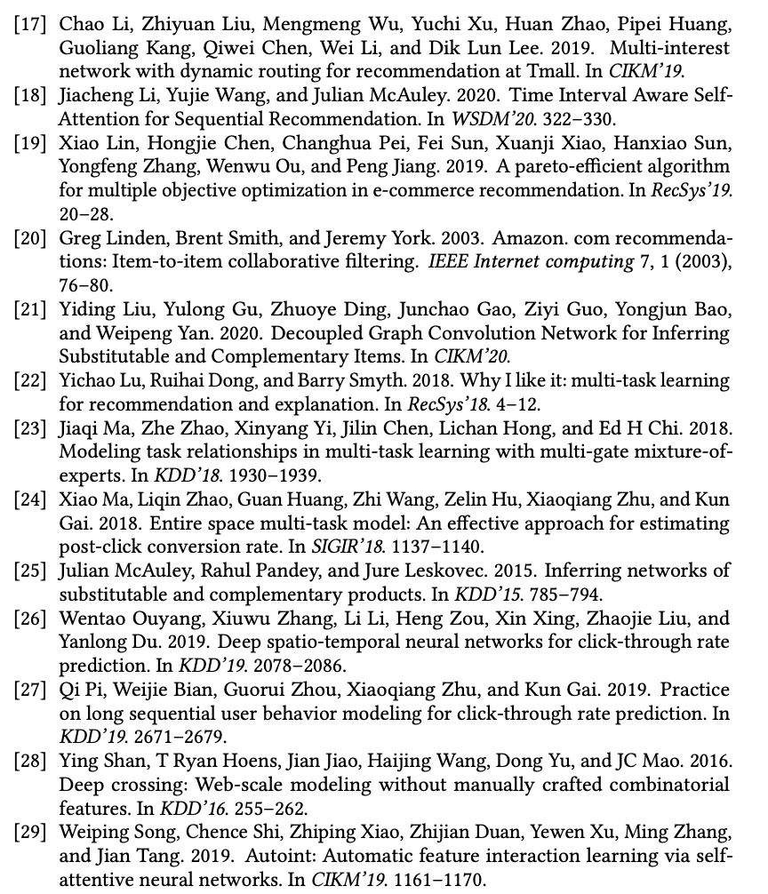
References

Slide 24
